Slide 1


Sambe Consulting BIOps Presentation 19 August 2024
Data Led: Intelligent Insights
www.sambeconsuting.com

Slide 2



Agenda
1
Understanding BIOps
3
2
Use Case Scenario
5
BIOps Workflow
3
7
4
Sequence of Demo
11
5
BIOps Demo
13

Slide 3


Understanding BIOps
By Ndivhudzannyi Tshikhovhokhovho
Data Led: Intelligent Insights

Slide 4


Understanding BIOps
Dev
Ops
Ops
BI
What is BI Ops?
It is the DevOps of BI.

Slide 5
Use Case Scenario
By Pranav Bhoola
Data Led: Intelligent Insights

Slide 6

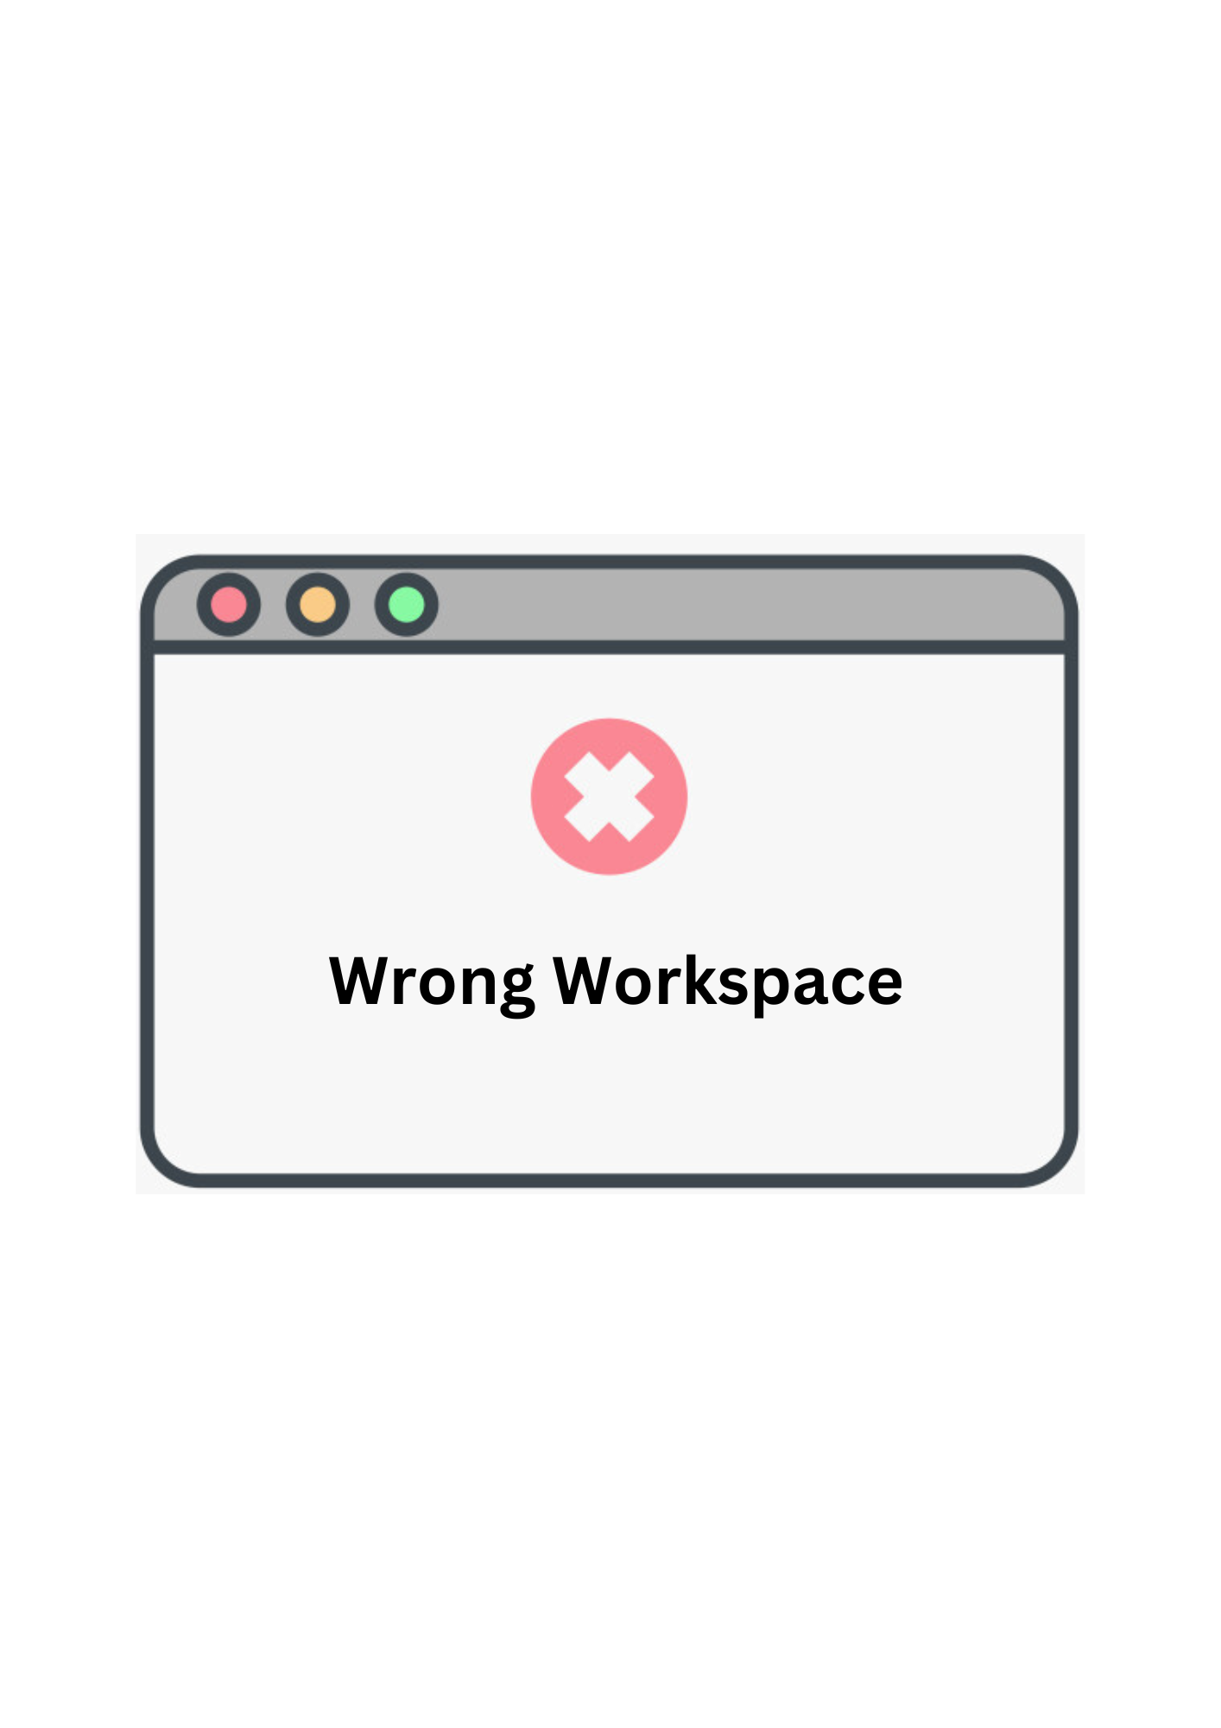



Use Case Scenario
Objective is to highlight the benefits of automating Power BI report deployments to Power BI Services and utilising GitHub for version control over manual processes.
Benefits of Automated Deployment with Version Control:
Minimised Human Error
Reduced Workload
Up-to-Date Reports
Enhanced Traceability and Collaboration

Slide 7
BIOps Workflow
By Bihaag Nepaul
Data Led: Intelligent Insights

Slide 8
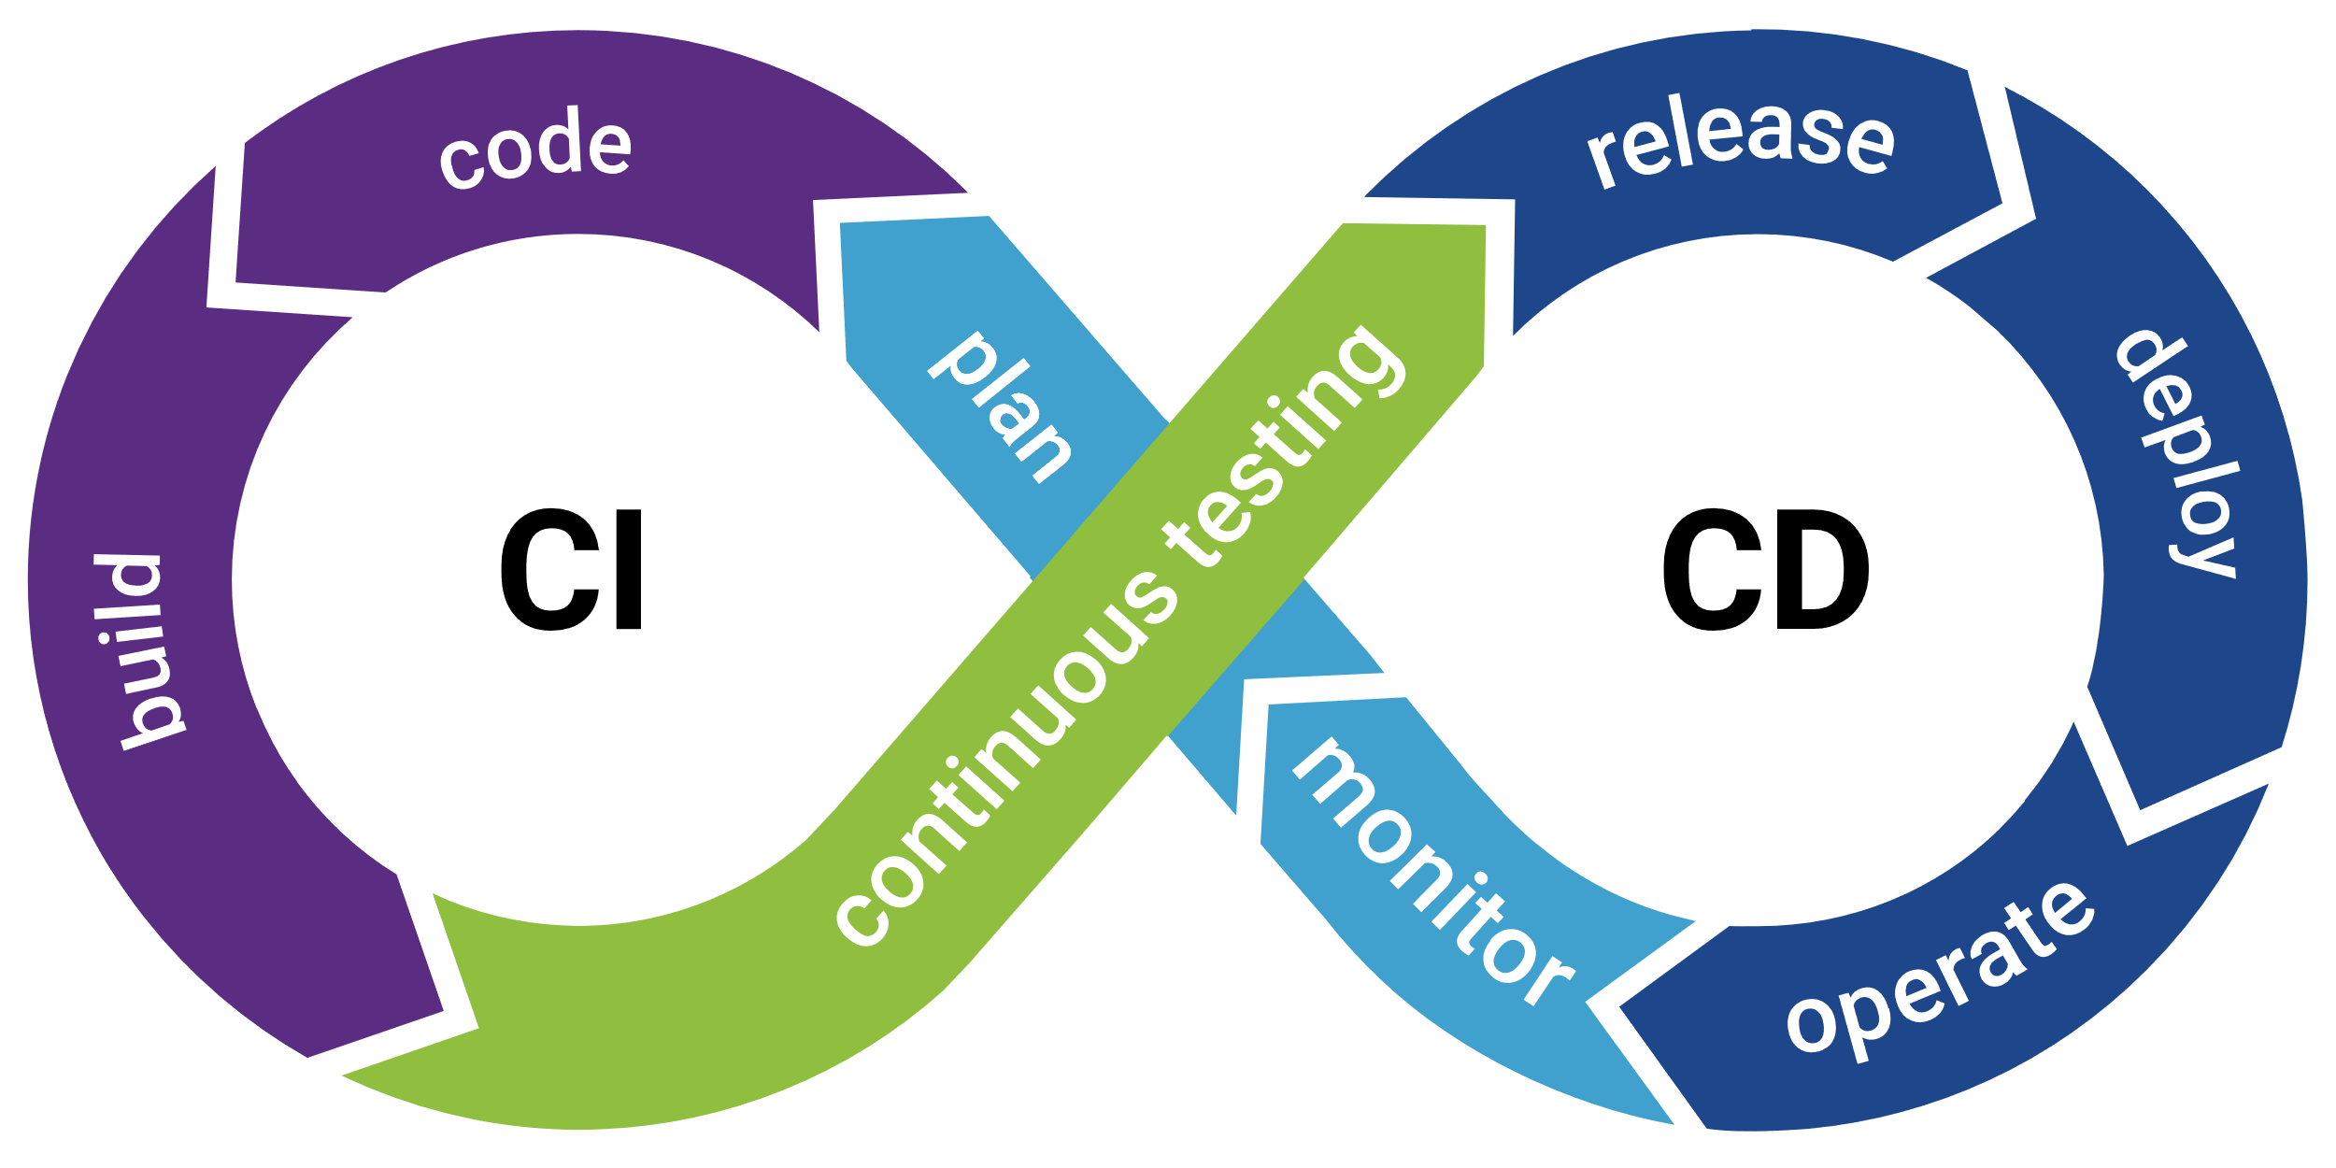
BIOps Workflow

Slide 9


BIOps Workflow (cont.)
CI Pipeline
Main-Branch
Looks Good Let's Deploy!
Dev-Branch

Slide 10







BIOps Workflow (cont.)
CD Pipeline
Client
Main
Power BI Service

Slide 11
Sequence of Demo
By Rivashan Govender
Data Led: Intelligent Insights

Slide 12







Sequence of Demo
Version Control
Deployment Automation

Slide 13
BIOps Demo
By Chosen Ones Graduate Team
Data Led: Intelligent Insights

Slide 14




Thank You
Chosen Ones – Sambe Consulting
2024 Graduates
-
info@sambeconsulting.co.za
www.sambe.co.za
1 Maxwell Drive, Woodmead, Sandton, 2191
Data Led: Intelligent Insights
www.sambeconsuting.com

